Slide 1

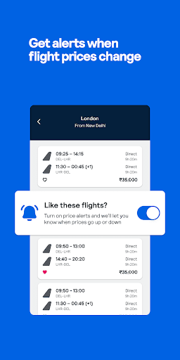

Skyscanner's Recommended Systems
Skyscanner, the popular travel search engine, utilizes advanced recommended systems to provide personalized flight and hotel suggestions to its users. This presentation will explore the different types of recommended systems and how Skyscanner leverages them to enhance the user experience.
by APARAJITA KUNDU

Slide 2

What are Recommended Systems?
1
Personalized Suggestions
2
Improved User Experience
Recommended systems analyze user preferences and behaviors to provide tailored recommendations.
They help users discover relevant products, services, or information they may not have found otherwise.
3
Increased Engagement
Effective recommended systems can boost user engagement and loyalty by providing valuable recommendations.

Slide 3
Types of Recommended Systems
Content-Based Filtering
Collaborative Filtering
Hybrid Filtering
Makes recommendations based on the preferences of users with similar tastes or behaviors.
Combines content-based and collaborative filtering to leverage the strengths of both approaches.
Recommends items similar to the ones a user has liked or interacted with in the past.

Slide 4

Content-Based Filtering
1
Analyzing User Preferences
2
Matching User Profiles
This method examines a user's past interactions, such as search queries and booking history.
It then matches the user's profile to similar travel options, recommending relevant flights and hotels.
3
Personalized Recommendations
Content-based filtering provides individualized recommendations tailored to each user's unique preferences.

Slide 5
Collaborative Filtering
User-Item Interactions
Finding Similar Users
Community-Based Approach
It then identifies users with similar preferences and recommends items they have enjoyed.
This approach analyzes the interactions between users and travel products, such as ratings and reviews.
Collaborative filtering leverages the collective intelligence of the user community to provide recommendations.

Slide 6

Hybrid Filtering
Combining Strengths
Overcoming Limitations
Hybrid filtering combines content-based and collaborative approaches to provide more accurate and comprehensive recommendations.
By leveraging both user-specific and community-based data, hybrid systems can overcome the limitations of individual methods.
Improved Accuracy
The synergistic effect of hybrid filtering leads to more relevant and personalized recommendations for users.

Slide 7




Skyscanner's Recommended System
Personalized Search
Intelligent Recommendations
Continuous Improvement
Skyscanner's recommended system analyzes user search history and preferences to provide tailored flight and hotel suggestions.
Skyscanner's recommended system utilizes machine learning algorithms to enhance the accuracy of its suggestions over time.
The system leverages a combination of content-based and collaborative filtering to offer relevant and valuable recommendations.

Slide 8
Stages involved in the personalized travel suggestion
Data Collection
Model processing
Personalized recommendation delivery
User Data
Collaborative Filtering(Analyses user patterns to recommend popular destinations.)
Content-Based Filtering(Matches user history with destination attributes.)
Hybrid Model(Combines both techniques for enhanced accuracy)
Personalized Travel Suggestion

Slide 9
Model Processing:
Collaborative Filtering:
Purpose: Identifies patterns in user behavior by grouping users with similar travel choices.
User-User Collaborative Filtering: This compares users to identify patterns in their preferences. For instance, if two users have chosen similar destinations in the past, Skyscanner may suggest other destinations that one has visited to the other.
Item-Item Collaborative Filtering: This matches destinations based on similar ratings or booking history among users. Destinations frequently booked together (e.g., a beach resort and a coastal town) are recommended based on the relationship between items.
Item-Item Collaborative Filtering: This matches destinations based on similar ratings or booking history among users. Destinations frequently booked together (e.g., a beach resort and a coastal town) are recommended based on the relationship between items.

Slide 10
Model Processing:
Content-Based Filtering:
Purpose: Focuses on each user's individual preferences, such as destination types, amenities, and travel activities.
Profile Creation: A user profile is created based on features from their travel history, such as destination type, activities (e.g., hiking), or amenities (e.g., spa).
Feature Extraction: The system analyzes the features of destinations and activities the user has engaged with to create a rich profile. For example, a user who frequently books eco-lodges or nature retreats will have “eco-friendly” or “nature-focused” marked as key profile attributes.
Similarity Scoring: New destinations are compared to this profile, scoring options based on similarity to the user’s past choices. Destinations with a high match to the profile (e.g., tropical beach vacations for a user with a preference for warm climates) are recommended

Slide 11
Model Processing:
Hybrid Model:
Purpose: Combines insights from both collaborative and content-based filtering to provide balanced, accurate recommendations.
Weighted Combination: In a simple hybrid approach, Skyscanner assigns weights to recommendations from collaborative and content-based filtering. The system might prioritize collaborative filtering slightly more for new users, then adjust toward content-based filtering as user preferences become clearer.
Switching Approach: Depending on data availability, the system dynamically switches between collaborative and content-based models. For instance, if a user has minimal interaction history, the model might rely more heavily on collaborative filtering, while established users might see more content-based suggestions.
Model Stacking: Advanced hybrid models “stack” the outputs of multiple algorithms, feeding them into a final meta-algorithm that learns optimal weighting for each input. This meta-model uses both content-based attributes and collaborative patterns, offering the highest personalization and relevance

Slide 12
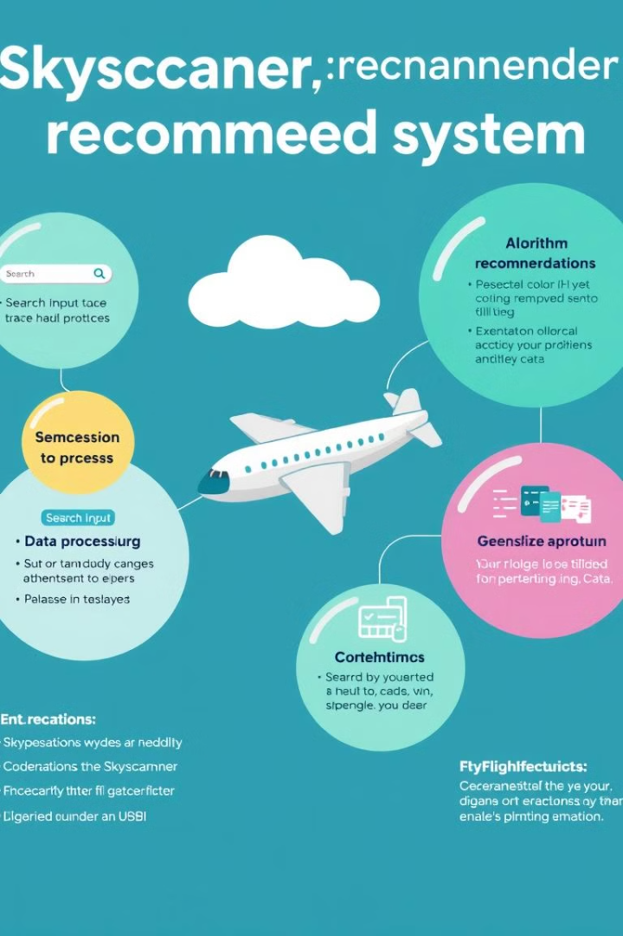
How it Works
1
Data Collection
Skyscanner gathers user search history, booking data, and community interactions to build user profiles.
2
Filtering Algorithms
The system applies content-based and collaborative filtering algorithms to analyze user preferences and identify similar patterns.
3
Recommendation Generation
Based on the insights gained, the system generates personalized flight and hotel recommendations for each user.

Slide 13
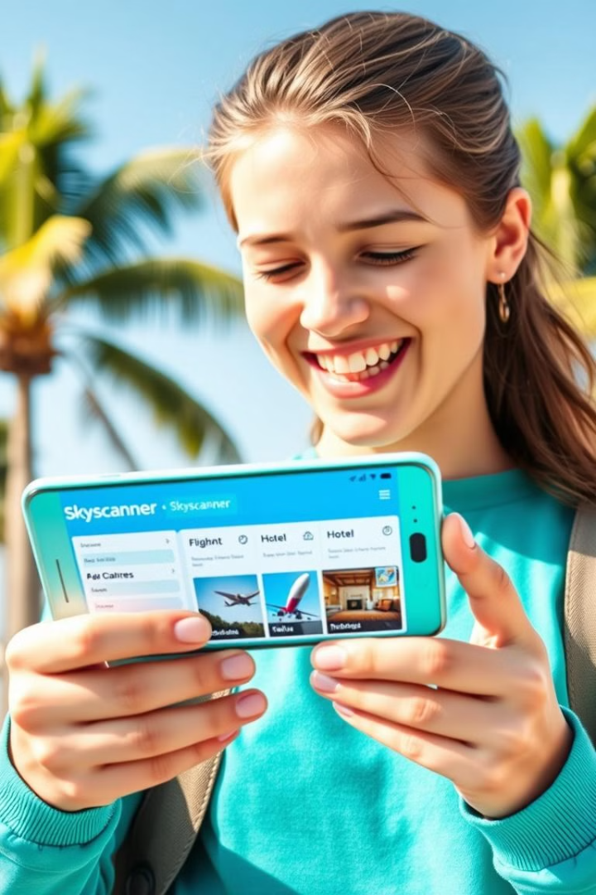
Benefits of Skyscanner's Recommended System
Improved Conversion Rates
Enhanced User Experience
Skyscanner's personalized recommendations lead to higher engagement and more bookings from users.
Users appreciate the convenience and relevance of the recommended flights and hotels, improving customer satisfaction.
Increased Loyalty
Reliable and valuable recommendations keep users coming back to Skyscanner, fostering long-term brand loyalty.

Slide 14
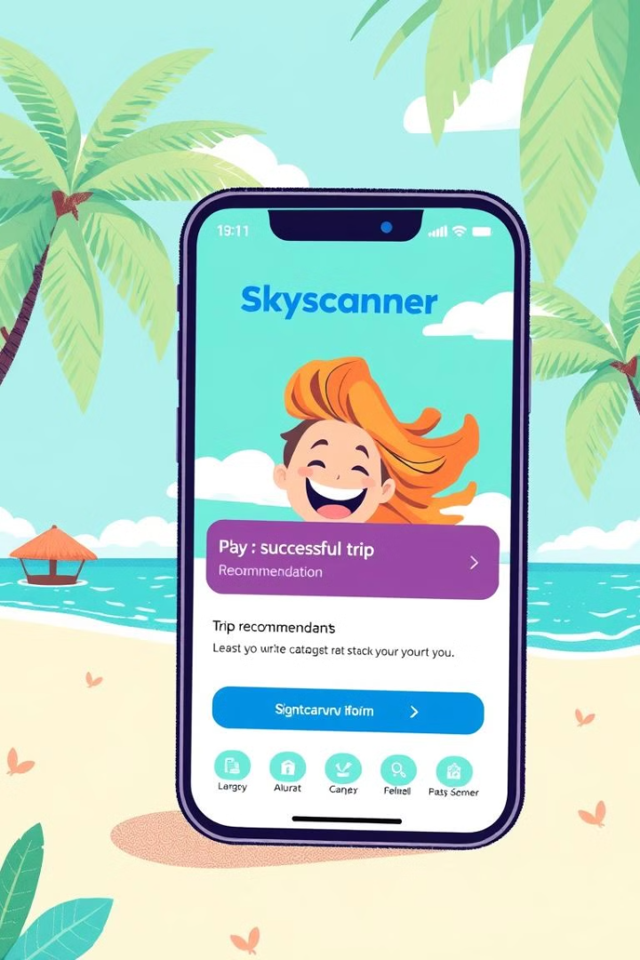




Case Study: Skyscanner's Recommendations
User Search
A user searches for a flight from London to New York on Skyscanner.
Recommendation Analysis
Skyscanner's recommended system analyzes the user's search history and preferences.
Personalized Suggestions
The system provides the user with a list of relevant flight and hotel options, tailored to their needs.
Booking Conversion
The user finds a suitable flight and hotel package and proceeds to book their trip through Skyscanner.

